Slide 1
Increasing Adoption of HIV Pre-Exposure Prophylaxis PrEP in Sub-Urban Ontario
Endgame Project- OHTN

Slide 2
Rationale

Slide 3

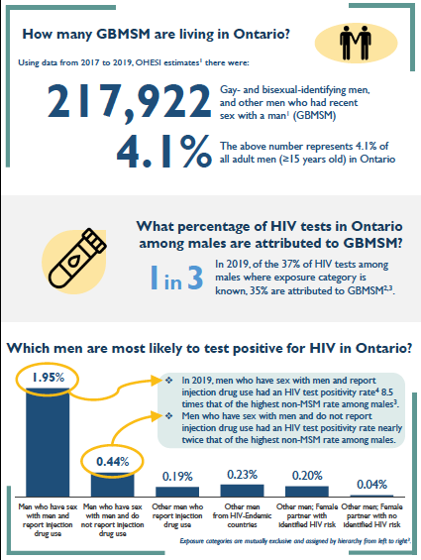
HIV epidemiology update for GBMSM in Ontario 2019
In Ontario, 62-67% of individuals with incident HIV infection are GBMSM
Approx. 40% of GBMSM report condomless anal sex in Vancouver.
Approx 28% of GBMSM reported CAS in Vancouver (Dec 2027)
In Australia, 57.9% of new HIV diagnosis occurred in individuals who had taken PrEP once before and who were not on PrEP at the time of diagnosis.
Successful PrEP in NSW and Victoria, Australia had a 36.38% uptake among GBMSM which contributed to a 66% HIV incidence reduction 2010-2019.
Few PrEP users in SEO
HIV epidemiology update for gay, bisexual, and other men who have sex with men in Ontario, 2019 accessed at https://www.ohesi.ca/wp-content/uploads/2022/05/GBMSM-Factsheet-ENGLISH-2022MAY04.pdf
https://bccfe.ca/wp-content/uploads/2024/05/kiffer_card_-_an_event-level_analysis_of_the_interpersonal_factors_associated_with_condomless_anal_sex_among_gbmsm_with_online-met_partners.pdf
https://www.croiconference.org/abstract/hiv-incidence-in-users-of-hiv-preexposure-prophylaxis-in-australia-a-whole-of-population-analysis/
https://www.thelancet.com/journals/lanhiv/article/PIIS2352-3018(23)00050-4/abstract

Slide 4
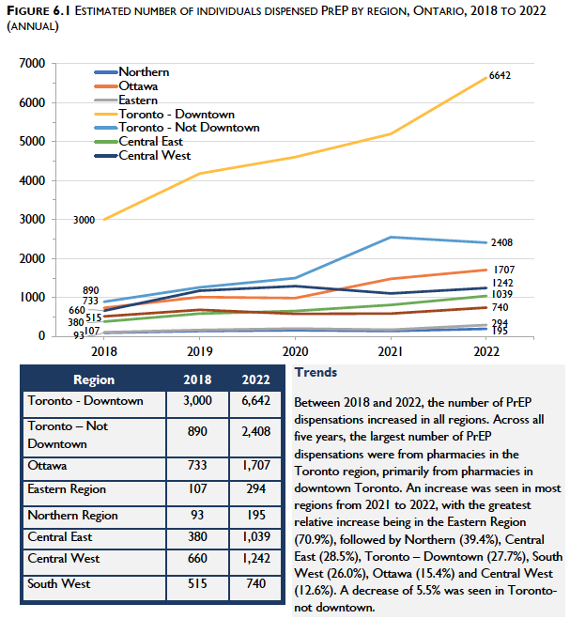
HIV PrEP utilization in Ontario
Individuals dispensed PrEP at least once: 14,650 Oct-Dec 2022
Individuals dispense PrEP at least once Jan-Mar 2021 to Oct-Dec 2022: 10,131
75% dispensed in Toronto and Ottawa
97% of users are male
HIV pre-exposure prophylaxis (PrEP) in Ontario, 2022 accessed at https://www.ohtn.on.ca/wp-content/uploads/2024/03/OHTN-PrEP-report-2022.pdf

Slide 5
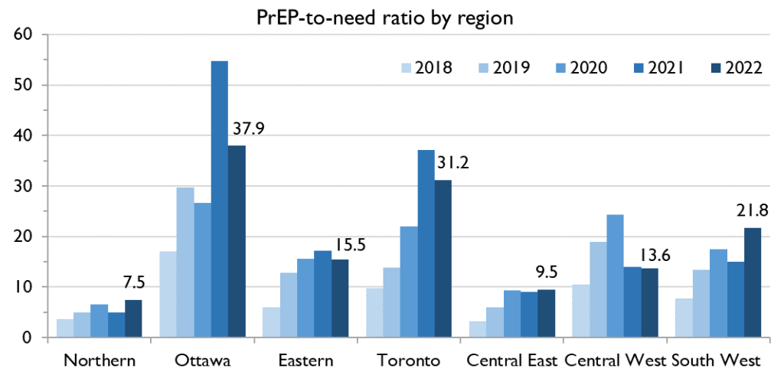
PreP adoption concentrate in urban areas
PrEP-to-need ratio” (a calculated measure of PrEP provision relative to HIV burden among a population, where larger numbers indicate a more optimal amount of PrEP use)
Ontario HIV Treatment Network. HIV pre-exposure prophylaxis (PrEP) in Ontario, 2022. Toronto, Ontario, March 6, 2024

Slide 6
Objectives

Slide 7
Implementation grant to increase adoption of PrEP in suburban Ontario
AIM 1. Conduct formative work with PCPs to identify 1) the PCP’s level of willingness and intention to become consistent PrEP prescribers, 2) PrEP adoption determinants among PCP, managers, and other key stakeholders, and 3) gather recommendations to address adoption barriers.
AIM 2. To use the collective experience in PrEP implementation to formulate 1) a training plan for PCPs, and 2) rapid PrEP implementation strategies/protocols that adjust to different clinic settings
AIM 3. To roll out and evaluate a PrEP training program for PCPs
AIM 4. To roll out and evaluate rapid PrEP implementation strategies
Project funded by OHTN- PI: Dr Martinez, Dr Guan and Dr Stoner

Slide 8
AIM 1. Conduct formative work with Primary Care Providers

Slide 9
To identify the PCP’s level of willingness and intention to become consistent PrEP prescribers, and
To identify PrEP adoption determinants among PCP, managers, and other key stakeholders,
To gather recommendations to address adoption barriers.
Specific Objectives
Methods
1.1.- Online survey in Qualtrics
1.2- Qualitative interviews with potential adopters and low intention PCP
1.3-Qualitative interview with PCPs and managers of sexual health clinic
1.4- Team discussion to delineate strategies
PCP, primary care providers; PrEP, pre-exposure prophylaxis

Slide 10
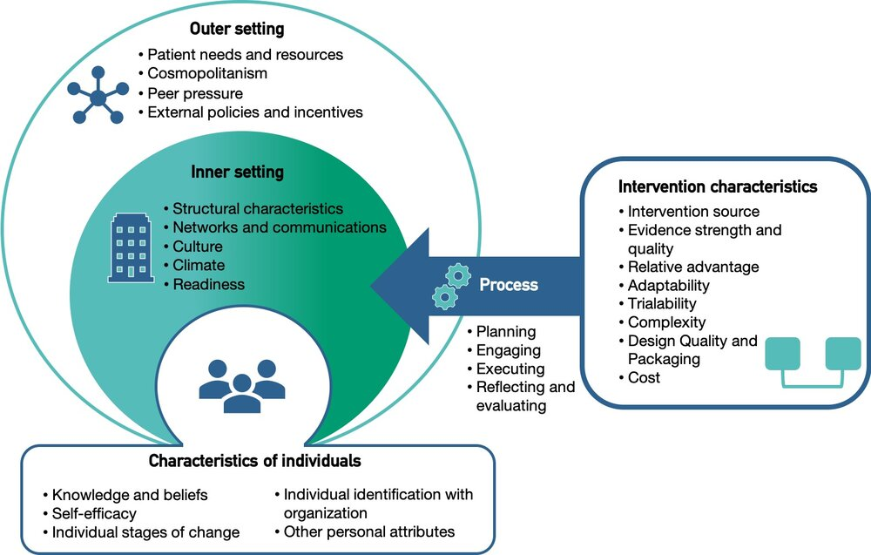
Consolidated Framework for Implementation Research (CFIR). Adapted figure by the center for implementation
https://thecenterforimplementation.com/

Slide 11
Sample and study population
Primary care practitioners, mostly physicians working in Southeastern Ontario accessible through primary care council
Primary care practitioners and clinical managers mostly nurses who work in sexual clinics accessible through KFLA and other public health units
Primary care practitioners, managers, mostly physicians working in Queens, St Lawrence, Street health, community centers.

Slide 12
Content of the survey
Awareness of PrEP
Use of educational resources for PrEP- ontprep
PrEP cascade
Intention to provide PrEP care or advocate for PrEP
Perceptions of characteristics of PrEP
Beliefs about abilities to manage patients on PrEP
Professional role
Social influence
Perception of needs of PrEP in the population
Beliefs about personal consequences/rewards
Clinical skills for PrEP
Practice and demographics
CME preferences

Slide 13
Content of the interview guide
General information of the interviewer and the clinic
Characteristics and perceptions of PrEP
Implementation of PrEP in the clinic- intention *
Leadership and external influences*
Implementation of PrEP in the clinic in relation to risk groups
Training of health providers
Awareness/use of PrEP resources

Slide 14
Theme 1. Limited resources to implement/offering PrEP
Main themes resulting from qualitative interviews
Disruption of sexual programs because of Covid-19
Not enough HCP familiar with PrEP
Limited resources at organizational level
Redirection of resources
We do not have enough knowledge
There is not formal training
Disruption of preventing programs
We do not have the capacity
Training needs
Who is going to be the provider

Slide 15
Theme 2-Barriers for getting people on PrEP
Theme 3-Reccomendations
Raising awareness
connections
Cost
Stigma
Expert support
Medical directives
Concerns
Mental health
Hiring new staff
Main themes resulting from qualitative interviews

Slide 16
Barriers for adoption in sexual health clinics identified in qualitative interviews
Lack of human resources, laboratory support
lack of awareness in populations
Individual factors
Cost and complexity
COVID-19 depletion of resources, need of adaptation, lack of ministerial support
Organizational factors
lack of local leadership support
Lack of providers
External factors
HIV stigma, and social determinants
Do not know the demand for PrEP, cost of implementing PrEP
Lack of training in primary care providers
Gather information through interviews - 12 Sexual Health Clinic
  2 prescribed PrEP on site
  6 Referred patients with established path
  2 Referred patients without established path
  2 no familiar with PrEP enough to offer or referred appropriately
Notes:
Two sites are already implementing PrEP on site, one has implemented referrals and initiated a plan to provide PrEP on site, and six have established paths for referral of clients but are not interested in prescribing PrEP on site, mainly because they have a referral path that works; two sites refer PrEP clients but the referral paths are weak, and two settings have low familiarity with PrEP, meaning they talk about PrEP with clients and do not have an established and working referral path for PrEP

Slide 17
Determinants of familiarity and experience with PrEP in PCP – Survey- 54 from 900 PCPs invited
Concerns about PrEP use, stigma and risk compensation were low, contrasting with earlier reports
Providers expressed more concern about unequal access, cost, monitoring, and adherence to PrEP
Familiarity with PrEP is a key determinant of adoption and correlates with positive perceptions of its effectiveness and simplicity in PrEP guidance and policies in Ontario, Canada
PCPs with higher familiarity and experience with PrEP are concentrated in specific organizations that served populations likely to seek sexual health services.
Positive support from leaders and colleagues who endorse PrEP was associated with higher PrEP familiarity and experience among PCPs
Skills in testing, counseling, and managing HIV medications are associated with both familiarity and experience with PrEP
Sexual health clinics and primary care settings as suitable venues for PrEP services in contrast to earlier beliefs that HIV specialist settings were best
Notes:
Two sites are already implementing PrEP on site, one has implemented referrals and initiated a plan to provide PrEP on site, and six have established paths for referral of clients but are not interested in prescribing PrEP on site, mainly because they have a referral path that works; two sites refer PrEP clients but the referral paths are weak, and two settings have low familiarity with PrEP, meaning they talk about PrEP with clients and do not have an established and working referral path for PrEP

Slide 18
Outcomes of AIM 1
Determinants of PrEP prescription in PCPs (report No 1)
Barriers and facilitators in Sexual health clinics (Report no 2)
Mapping of barriers and facilitators with strategies and interventions

Slide 19
AIM 2a. To use the collective experience in PrEP implementation to formulate a training plan for PCPs

Slide 20
Methods
Litterature review
Current study
First outcome
Second outcome
All studies on PrEP in USA until 2020 categorized by knowledge, motivation, skills and opportunities
29 interviews with some information on educational needs and reccomendations
Identify which knowledge, skills, motivations and educational resources are needed to the prescription of PrEP
Identify educational learning objectives , resources and tools
Expand that review to include Canadian studies
50 surveys with information on preferences skills and motivations
Identify best practices for educational activities that may increase PrEP prescription in PCPs
Manuscripts, abstracts for conferences

Slide 21






Course Development Process
Module Launch!
START
MODULE FINALIZATION and FRENCH TRANSLATION
1
2
3
4
5
6
Establish Content Outline
Review and Finalize Outline
Curate Content & Develop Learning Interactions
Review, Feedback, Revise
Creation of Online Module
Final Testing
Stakeholder Collaboration & Feedback
PROJECT KICKOFF
OPDES COURSE DEVELOPMENT
Notes:
https://www.flaticon.com/free-icon/binoculars_1527246?term=binoculars&page=1&position=4&page=1&position=4&related_id=1527246&origin=search
https://www.flaticon.com/free-icon/small-notepad-and-pencil-outlines_38090?term=outline&page=1&position=18&page=1&position=18&related_id=38090&origin=search
https://www.flaticon.com/free-icon/complaint_2519057?term=review&related_id=2519057
https://www.flaticon.com/free-icon/collaborate_2646168?term=collaboration&page=1&position=41&page=1&position=41&related_id=2646168&origin=search
https://www.flaticon.com/free-icon/shop_1831950?term=module&page=1&position=38&page=1&position=38&related_id=1831950&origin=search
https://www.flaticon.com/free-icon/settings_173761?term=tools&page=1&position=84&page=1&position=84&related_id=173761&origin=search

Slide 22
Needs, preferences and recommendations for PrEP training
Report No 1
Expert support, shadow, and continous mentorship
Formalizing Training in institutions
Incentives, time, resources, budget and clinical support
Knowledge and skills on medication and counseling
Policies and medical directives
Mixed strategies, shadow, clinical cases, expert discussions

Slide 23
Overview of course content (see more in report No 3)
SECTION | OBJECTIVES | CONTENT
SECTION 1 PREP BASICS | Describe What PrEP is, how it works, and what it is for. Identify the medications used in oral PrEP and its efficacy/effectiveness Knowledge Recognize PrEP overall safety and specific side effects | Video, key messages developed by researchers
Section 2. PrEP basic skills | Learn how to obtain a sexual history and feel comfortable doing it Learn how to help patients assess their risk of HIV acquisition. Learn what needs to be included in PrEP counseling and effectively deliver PrEP counseling with your patients Learn how to identify individuals at high risk of HIV acquisition | Summary of key points, link to card from PreP Ontario Video on counseling for PrEP Link to cdc acquisition tool risk Summary of guidelines for indication of PrEP in different populations
Section 3. Building additional knowledge and skills | Learn how to assess the risk of HIV and identify an acute HIV infection. Learn how to start an individual in PrEP. Learn how effectively do an adherence counseling. Learn how to monitor adverse effects | Video on starting patients on PrEP by prepontario Summary of PrEP options Resource and link for support PrEP adherence Summary of side effects and links to drug interaction sites and additional documents
Section 4. Prep coverage and expert support | Gain understanding of how PrEP can be covered in Ontario How to contact PrEP expert support when needed. | Link to resources

Slide 24
AIM 2b. To use the collective experience in PrEP implementation to formulate a rapid PrEP implementation strategies/protocols that adjust to different clinic settings

Slide 25
Methods
Identify strategies using Eric tools- see excel file – Report No 2)
Literature review of best practices
Description of Implementation process using qualitative interviews (Report No 2)
Description of actors and needs (Report No 4)

Slide 26
Strategies identified to address barriers
Conduct educational meetings.
Conduct ongoing training.
Create learning collaborative.
Develop and distribute educational materials
Access new funding to support physician /NP
Provide local technical assistance
conduct educational outreach visits
Identify and prepare champions
Identify early adopters
Increase awareness in populations/ involve community
Conduct local assessment/ involve community
Promote adaptability/ innovative services

Slide 27
DETERMINANTS
Interventions and strategies
Our program
Implementation outcomes
Outcomes
Education and training
Coalition with Queens medicine, PHS, Nursing and KFLA; community of practice
Individual characteristics: Knowledge and skills , awareness, social barriers
Reach/Penetration
Service: efficiency, safety, effectiveness, equity, patient centered, timeliness
Prepare leaders
Acceptability
alter funding incentives
Appropriateness
Characteristics of the intervention: cost, need of adaptations
Feasibility
Client: reduction of HIV risk, satisfaction, better sexual health
Promote adaptability
PREP training, online PrEP resources
Adoption
Outer setting: local conditions, leadership, policies, networks
Conduct local assessments
Implementation tools: readiness, lab kits…
Cost
Build new coalitions
Maintenance
Evaluation tools: REAIM framework
Inner setting: resources, compatibility, priority, learning needs
Involvement of community
LOGIC MODEL OF PLANNING AND EVALUATION OF IMPLEMENTATION OF
PREP PROGRAM
Measuring implementation outcomes: An updated systematic review of measures’ psychometric properties
Delivery innovation: telemedicine, SMS

Slide 28
Outcomes of AIM 2
Development of training module (report No 3)
Identification of strategies(Report no 4)
Logic model for implementation
Identification on main knowledge skills and methods to deliver PrEP education
Identification of implementation strategies to increase adoption of PrEP

Slide 29
AIM 3. To roll out and evaluate a PrEP training program for PCPs

Slide 30
Training module evaluation (Report No 3)
Pre-post training design
Invite 250 primary care providers
38 complete the module
21 give post training feedback
8 give three months feedback

Slide 31
Main results
PCPs’ referral patterns (≤ 10 patients) and contact with infections disease doctors increased moderately and respectively by 25% and 13%.
PCPs’ knowledge about the criteria used for initiating same-day PrEP increased significantly by 134%.
Knowledge about referrals for patients who required unplanned PrEP discontinuation increased significantly by about 180% after completing the training module.
Learners’ knowledge about how to perform a planned PrEP discontinuation increased significantly by 84%.
Significant increases were observed for knowledge about resources required for determining financial coverage for PrEP patients (73%) and how to guide patients to obtain PrEP coverage (83%).
Knowledge about skills required to administer PrEP medications increased between 57% to 81% while increases in knowledge about how to start PrEP ranged from 19% to 46%.
Knowledge about who can take TDF/FTC or TAF/FTC for PrEP respectively increased by 65% and 80%.

Slide 32
Main results
There were significant improvements in learners’ knowledge regarding how to prescribe PrEP daily or continuously (67%) or how to prescribe TDF/FTC for PrEP (57%) or TAF/FTC for PrEP (72%) or PrEP on demand (68%).
PCPs’ comfortability regarding PrEP decision making, counseling, and prescription significantly increased by 47%, 37%, and 38% respectively.
PCPs’ confidence level about how to rapidly find answers and support in situations outside their knowledge base increased significantly by about 18%.
All learners (100%) agreed that the module met their expectations and was applicable to their learning in their clinical environment.
All learners (100%) reported that they gained new knowledge and skills after completing the module.
Learners found strengths of the module to be comprehensive, accessible, and easily navigable. They appreciated the straightforward information and resources, which are useful for future reference.
Weaknesses of the module include concerns that it was too detailed and technical in content and had limited supplementary materials.

Slide 33
Outcomes of AIM 3
Evaluation of a PrEP training module for PCPs (Report no 3)
Module to be delivered online available for PCPs

Slide 34
AIM 4. To roll out and evaluate rapid PrEP implementation strategies

Slide 35
4a. To identify strategies implemented in one SHC and evaluate its implementation
4b. To identify the readiness of other SHC and develop a plan for implementation
Specific Objectives
Methods
4.1.- Evaluation of PrEP delivery in one SHC using REAIM
4.2. Assess other SHC readiness and plan of adoption through personal meetings with team leaders

Slide 36
4a. To identify strategies implemented in one SHC and evaluate its implementation

Slide 37
Proposal for PrEP evaluation in one sexual health clinic
Use a mixed method design, combining concomitant surveys, use of already collected data and qualitative methods to gather information on staff and clients.
Retrospective collection of data already gathered or prospective evaluation
Possibility of evaluate implementation strategies that have worked in KFLA, or implement new ones and evaluate
Qualitative methods may include: process mapping, focus groups, and interviews

Slide 38
RE-AIM Dimension | Key Pragmatic Priorities to Consider and Answer
Reach (Individual Level) | WHO is (was) intended to benefit and who actually participates or is exposed to the ‘program’ or policy?
Effectiveness (Individual Level) | WHAT is (was) the most important benefit you are trying to achieve and what is (was) the likelihood of negative outcomes?
Adoption (Setting Levels) | WHERE is (was) the program or policy applied WHO applied it- and who did not?
Implementation (Setting Levels) | HOW consistently is (was) the program or policy delivered? HOW will (was) it be adapted? HOW much will (did) it cost? WHY will (did) the results come about?
Maintenance (Individual and Setting Levels) | WHEN will (was) the program become operational; how long will (was) it be sustained (setting level); and how long are the results sustained (individual level)?
Glasgow RE & Estabrooks, P. Preventing Chronic Disease, 2018; 15: E02
Notes:
Program, policy, product. Intervention, innovation, assessment

Slide 39
GENERAL QUESTION
EQUITY QUESTION
Are PrEP services an acceptable program for staff, patients, and managers of the sexual clinic?
Is the program acceptability driven by specific populations?
ACCEPTABILITY
Glasgow RE, Estabrooks PE. Pragmatic Applications of RE-AIM for Health Care... Prev Chronic Dis 2018;15:170271. DOI: http://dx.doi.org/10.5888/pcd15.17027

Slide 40
GENERAL QUESTION
EQUITY QUESTION
What is the level of Reach?
WHO is (was) intended to benefit and who is actually participating in the PrEP program?
What are the characteristics of populations reach by PrEP?
Who is not participating and why?
To what extent is your project equitably reaching the intended participants that are socially and economically disadvantaged?
REACH
Glasgow RE, Estabrooks PE. Pragmatic Applications of RE-AIM for Health Care... Prev Chronic Dis 2018;15:170271. DOI: http://dx.doi.org/10.5888/pcd15.17027
Notes:
For each of the RE-AIM dimensions, there is a technically correct definition and a “who, what, where, how, and when” question to guide pragmatic use.
The first dimension is Reach which refers to the absolute number, proportion, and representativeness of individuals who are willing to participate in a given initiative, program, or intervention. For reach, the key pragmatic priority to consider is WHO is or was intended to benefit and actually participate or be exposed to the intervention?

Slide 41
GENERAL QUESTION
EQUITY QUESTION
WHAT is (was) the most important benefit you are trying to achieve and what is (was) the likelihood of negative outcomes?
WHAT is the effectiveness of the PrEP program in the sexual health clinic?
WHY will (did) the results come about?
Are the effectiveness achieving in which populations? Have the services had unintended consequences? For whom?
To what extent is your project effective for participants who are socially and economically disadvantaged?
EFFECTIVENESS
Glasgow RE, Estabrooks PE. Pragmatic Applications of RE-AIM for Health Care... Prev Chronic Dis 2018;15:170271. DOI: http://dx.doi.org/10.5888/pcd15.17027
Notes:
The second dimension of RE-AIM is Effectiveness, which is the impact of an initiative, program, intervention, or policy on important outcomes, including potential negative effects, quality of life, and economic outcomes. The key pragmatic consideration is WHAT is or was the most important benefit you are trying to achieve and what is or was the likelihood of negative outcomes?

Slide 42
GENERAL QUESTION
EQUITY QUESTION
What is the level of adoption, and which were the changes required to adopt PrEP?
WHO is offering the services?
What are the characteristics of the providers of PrEP? Who is not participating and why?
ADOPTION
Glasgow RE, Estabrooks PE. Pragmatic Applications of RE-AIM for Health Care... Prev Chronic Dis 2018;15:170271. DOI: http://dx.doi.org/10.5888/pcd15.17027
Notes:
The third dimension of RE-AIM is adoption which is defined as the absolute number, proportion, and representativeness of settings and intervention agents who are willing to initiate a program. Pragmatically, the question for adoption is Where is the program applied and who applied it?

Slide 43
GENERAL QUESTION
EQUITY QUESTION
What is the level of fidelity, and the cost of implementing PrEP?
HOW consistently is (was) the program delivered?
HOW will (was) it be adapted?
HOW much will (did) it cost?
Which adaptation may decrease inequities?
Could cost and adaptations increase inclusion?
IMPLEMENTATION
Glasgow RE, Estabrooks PE. Pragmatic Applications of RE-AIM for Health Care... Prev Chronic Dis 2018;15:170271. DOI: http://dx.doi.org/10.5888/pcd15.17027
Notes:
The fourth dimension of RE-AIM is implementation. At the setting level, implementation refers to the intervention agents’ fidelity to the various elements of an intervention’s protocol. This includes consistency of delivery as intended, adaptations made, and the time and cost of the intervention. The key pragmatic considerations are How consistently is or was the program or policy delivered? How will or was it be adapted? How much will it cost? And why did will or did the results come about?

Slide 44
GENERAL QUESTION
EQUITY QUESTION
WHICH factors are needed to sustain the PrEP program over time?
WHEN will (was) the project become operational; how long will (was) it be sustained (setting level); and how long are the results sustained (individual level)?
HOW LONG did the results last and HOW LONG was intervention delivery sustained?
How likely is it that your project will show sustained effectiveness over time (at a minimum 1-2 years) for socially and economically disadvantaged participants?
MAINTENANCE
Notes:
The last dimension of RE-AIM is maintenance which is defined as the extent to which a program or policy becomes institutionalized or part of the routine organizational practices and policies. Maintenance in the RE-AIM framework also has referents at the individual level based on sustained changes and long-term outcomes. The key pragmatic consideration for maintenance is When will (or did) the initiative become operational and how long are the results sustained at the setting level and individual level?

Slide 45
4b. To identify the readiness of other SHC and develop a plan for implementation

Slide 46
Readiness, plan and adoption: Key steps
1. Ensuring policy and procedural support
2. Adapting to local context /assessment of readiness/innovation of services
3. Getting prepared for client recruitment
4. Preparing stakeholders for the change/innovation of services
5. Developing an implementation action plan

Slide 47
SUMMARY OF HIV PrEP implementation readiness
Fully available resources
Partially available resources
Funding for PrEP implementation
Available prescriber
PrEP training Modules
Community partners
Human resources allocation
Medical directives
PrEP expert ongoing support
PrEP relevant?
PrEP promotion strategy (local)
Laboratory services
PrEP expert shadowing
Proficient providers
PrEP user communication support
STI treatment and prevention resources
Can PrEP services be incorporated to current practice?

Slide 48
Implementation/evaluation tools
Medical directives adapted to local needs
Laboratory requisitions
Supplies for STI testing
Billing codes
Taking a sexual history kit
PrEP self-assessment for clients
Guide for counselling on PrEP
Guide for adherence PrEP
Evaluation protocol-REAIM model
Client registration sheet
Substantial risk tool
Interview guide for clients
Interview guide for staff and managers
Flyers for PrEP for clients
Accessing funding for new clients

Slide 49
Ensuring policy and directives- leadership support
Examples of actions
What do we have?
Advocating to provincial regulators about changes in practice to receive their support
Plan to adjust the productivity measures while staff is in training
Adjust policies and procedures of the organization to include the delivery of the Evidence-based practice
Medical directives
Reports from our study to support your actions and decisions
Experts and networks to encourage leadership engagement
PrEP champions

Slide 50
Assessment of organizational readiness
Examples of actions
What do we have?
a) Assess potential resources and capacity of the organization and how they may be adjusted to implement as outlined
(b) Incorporating implementation and EBP application ideas from various resources (literature, other agencies, decision makers) in order to adapt the delivery of the EBP to the agency’s structure and capacity
(c) People from “all levels” meeting together to discuss how the implementation should look like locally
Readiness tool as based for discussion and identify need of resources
Learning experience from other SHC to adapt interventions or strategies

Slide 51
Preparing for clients for recruitment
Examples of actions
What do we have?
Involving referral sources prior to launching the program to make recruitment more efficient
Identifying potential participants from the program’s existing case load
Increase awareness of PrEP in populations
Partnership with CBO
Having a peer navigator
Network of researchers that can work on adapting recruitment materials
Experiences of other SHC that can be adapted

Slide 52
Preparing staff for change
Examples of actions
What do we have?
Consultant/developers collaborating with internal figures to explain how the EBP relates to local context
Conducting readiness assessment at the leadership and staff level: need to change, positive expectations of the change, self-efficacy (as an organization), support, resources
Providing overview of the expected change to all stakeholders
Readiness assessment to start a discussion
Community of practice-web page- on development
Training modules with implementation tools
Reports to make the case to leaders and other key stakeholders
Medical directives
Expert support for PrEP adoption

Slide 53
Developing an implementation action plan
Examples of actions
What do we have?
Developing goals, measures, and metrics for assessing implementation outcomes
Planning for staffing: - Decide on structure and selection process - Identify potential staff - Remove or reassign strong resisters
Planning for skill development—Developing a training plan to address different skill levels and knowledge needs
Developing oversight infrastructure: - Allocate resources for an implementation leader - Develop a taskforce/champions that represents all who are going to be affected by the change
Planning for resources allocation: - Identify resources requirements (space, time, staff, equipment, funding) and possible solutions- Communicate with the management about the demands of the EBP
Developing procedures for delivering the EBP
Logic model for implementation
Evaluation tools for the clinic
Training modules with implementation tools
Web page
Medical directives
Expert support for PrEP adoption

Slide 54
Conclusions
There continues to be a need to increase PrEP access in SEO
SHCs offer opportunities to increase PrEP access
Several elements necessary for PrEP implementation are available
Among the aspects that require further work include:
  Estimation of number potential PrEP eligible individuals that use SHC over time
  Estimation of resource allocation for PrEP services: what SHC
  Establish if resources to start/sustain PrEP services will become available
An assessment of readiness will help identify what else is needed.

Slide 55
Outcomes of AIM 4
Evaluation plan and results of a PrEP program in one SHC (report No 5)
Plan for adoption of PrEP in other SHC (report No 6)
Implementation tools for adoption of PrEP in Sexual Health Clinics

