Slide 1



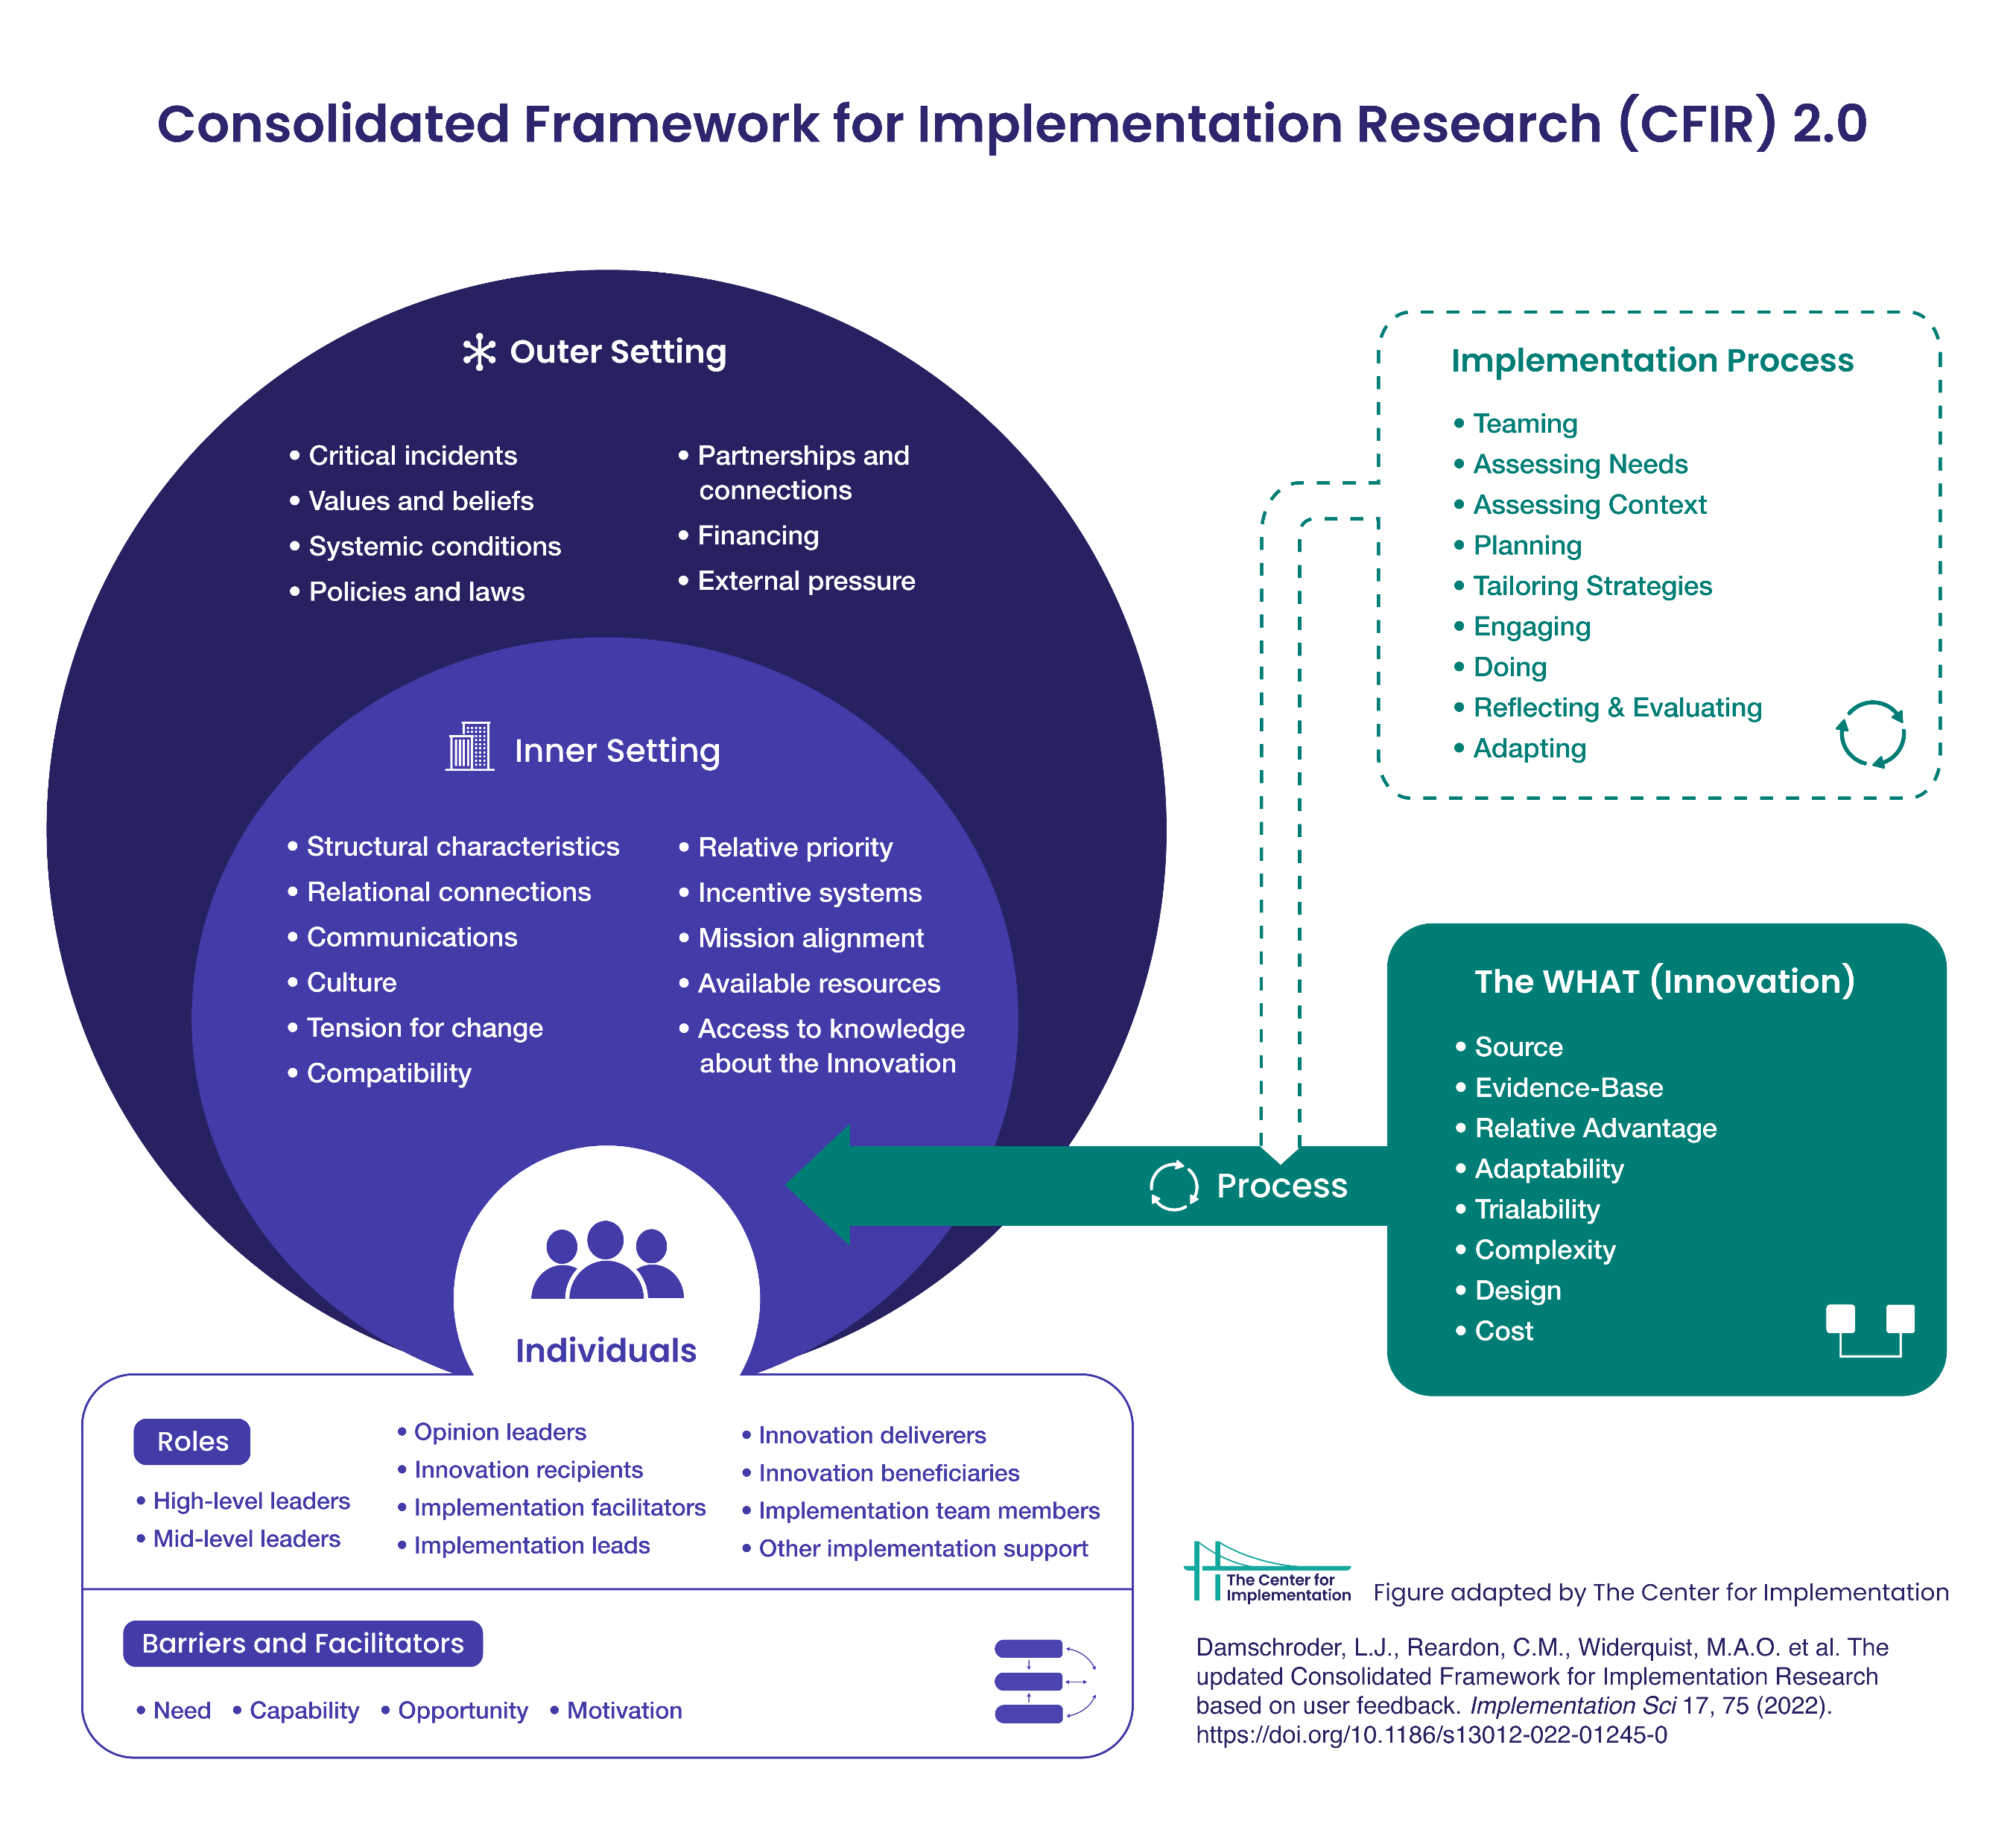
EPH.19.
Facilitators And Recommendations for PrEP Implementation in Southeastern Ontario:
Qualitative Findings from Public Health, Primary Care Providers, and Clinical Managers Working With Key Populations
T Hugh Guan^{1,2,3}, Emma Nagy², Bradley Stoner^{1,4}, Aamir Sholapur², Evan Wilson¹, Santiago Perez¹, Joseph Braimah⁴, Beatriz Alvarado⁴, Pilar Camargo⁵, Eva Purkey³, Kathleen Pouteau³,
Nicholas Cofie⁶, Nancy Dalgarno⁶, Oluwatoyosi Kuforiji Cofie⁶, Jorge Martinez¹
¹Department of Medicine, Queen’s University, ²Kingston, Frontenac, and Lennox & Addington Public Health, ³Department of Family Medicine, Queen’s University, ⁴Department of Public Health Sciences, Queen’s University, ⁵School of Nursing, Queen’s University, 6. Office of Professional Development
Participants description
Recommendations for PrEP adoption
Background
Experience with HIV care | As a medical student Providing guidance to practitioners who care for HIV patients Providing direct support to individuals living with HIV Public health residency training From attending to client and learned from Hotel Dieu Supporting people with AIDS and treating severe related illnesses Counseling clients and engaged with individuals changing their behavior Taking up a role within the sexual health program Educating and counseling for clients
The 16 participants have an average of six years in their current position, practice in several settings, and represent different roles including primary care physicians, clinical managers, nurses, and clinical educators. Of the 16, eight are in PCPs working in public health units.
Sub-theme | Relevant Narrative | CFIR domain
Having external support | One thing that we've talked about since this survey came to a few of us is having a policy. Like a written policy so that if we did have a practitioner came and didn't normally give PrEP they could quickly and easily read something and initiate in their own practice. Probably a policy to make it easier for them to get the learning under hand. P002. | Outer setting
More training | We need general education you know, case management in terms of you know, strategies for keeping people engaged with PrEP. You know, just more info on you know, we haven't really done a deep dive into PrEP. So just in terms of better understanding, you know, we haven't provided PrEP for clients. So just in terms of, you know, optimal case management. P018 | Individual and inner setting
Working closely to communities in need of PrEP | And how can we incentivize them to keep taking their medications or at least to get care, right to stay connected with their care. Because we also know that if you stay connected with care you have better outcomes not only for your health wise, but from a public health standpoint. So that was an incentive piece that we had done. P009. | Outer and inner setting
Innovative and creative with delivering care. | I don't know if we would need it [physician] because I know [deleted] has a PrEP RN clinic and so there are registered nurses are providing PrEP and it's a nurse practitioner that’s writing the medical directives, So if they can do it, then I think we can, we can do it. We could find a way to do it. P011. | Inner setting
There continues to be a gap in the adoption of PrEP in Ontario with only 36% of those who met Canadian PrEP guidelines receiving PrEP, and the highest PrEP-to-need ratio being mostly in urban centres such as Ottawa and Toronto (OHTN 2023).
The role of primary care providers (PCPs) in the uptake and adherence of PrEP is well recognized and the determinants of the adoption of PrEP included individual, interpersonal, organizational, and external factors (Pleuhs B et al., 2020).
Few studies in Canada has been conducted among PCPs and clinical managers in regards to organizational determinants of PrEP adoption, with many limited only to identify individual factors (Yoong D et al., 2015; Sharma M et al., 2014).
Intro
Most of the PCPs interviewed have familiarity or have provided PrEP. Although there is an interest in adoption of PrEP in public health led sexual health clinics in the region interviewed, only one offered PrEP.
Barriers for implementation
describe main barriers and facilitators PrEP adoption of PCP in suburban Ontario
Sub-theme | Relevant Narrative | CFIR domain
Lack of available resources (human and time) | So like I said, we're a little short on doctors right now. So, I think we have less than a dozen doctors that work with us. Some are family doctors, some are more emergency room doctors. So obviously the comfort levels and expertise varies. P003. So we don’t have, at this point at time, have any dedicated sexual health physicians that are working with us. So we have our medical officer of health, and we have the odd resident who is here that helps support some of the needs of our clients. But we don’t have any hours of service to facilitate ongoing thing that would need physician support. P013. | Inner setting
PrEP program not a priority | I just think it's [PrEP] not on the radar for a lot of people and I think there may be a perception that maybe there aren't that many people who could benefit from it in our population. But without more data, it's hard to know one way or the other. You know how many people could benefit from it. P004. | Inner setting (relative priority)
Lack of adequate knowledge | Yeah, I think part of it is that not all clinicians are, you know have enough knowledge to comfortably prescribe PrEP or counsel people about it. I think there's still a little bit of a belief that you know, oh, you have to be a specialist in order to do this. Or I don't have the knowledge to do it or it needs like extensive counseling and monitoring, which I think is kind of overblown. I think, you know, someone just needs to sit down for 20 minutes and explain how it works. And that's it. P004. | Individual characteristics
Cost, and funding | What can I tell you? It's expensive. There are gaps in access for a lot of individuals, particularly financial barriers to taking that, I know that there was initially back when we were starting to on board, trying to move away from it being something only an infectious disease specialist could prescribe and get it into the hands of primary care. P009. | Inner setting
Objectives and Framework
The study aims to use a mixed methods design (surveys, semi-structured interviews and literature reviews) to describe main barriers and facilitators for PrEP adoption by PCPs in suburban Ontario and delineate recommendations for increasing adoption.
Summary of key findings
describe main barriers and adoption of PCP in suburban Ontario
Following the CFIR model, we have identified facilitators, barriers and recommendations for PrEP adoption in PCPs, public health staff, and clinical managers with a diversity of clinical and community experiences. Our results are in agreement with reviews of literature on determinants of PrEP adoption. They also address a gap in the literature about structural factors towards PrEP adoption (Li D et al., 2022).
The domain of CFIR more relevant found in this study (as barrier and as facilitator) was the inner setting, that is factors related to the organizational aspects of clinics. Among these, the lack of availability of resources, in terms of human and time seem to disfavour adoption. Funding is another important barrier, influencing the offering and accessing PrEP. Similarly, the lack of protocols or directives and the lack of training of staff and in general PCPs constituted very common cited barriers in our participants. In this same sense, having available resources for training and tools for provision of PrEP in clinics favour adoption or interest in it.
The other domain perceived as relevant is that of the outer setting, specifically awareness of the need of PrEP in populations, and the demand of PrEP from patients/clients seem to favour adoption. Related to this is the positive attitudes of PCPs regarding PrEP (individual characteristics and intervention characteristics )
The CFIR model was used to design survey, interview guide, identify barriers and facilitators, and suggest recommendations (Damschroder LJ et al. 2022).
Study population: Primary Care Providers
Setting: Southeastern Ontario, semi-urban and rural clinics.
Facilitators for implementation
Targeted population: 1) PCPs and clinical managers working in primary care, post-secondary student health, street health, and community health centers. 2) Healthcare workers in local public health agency sexual health clinics
Sub-theme | Relevant Narrative | CFIR domain
Networking | We have relationship with [deleted] infectious disease clinic. So, we have some ability to make referrals if needed, consult as needed and [deleted] itself would be probably likely to refer clients to us.. Nothing municipally, though. P009. | Inner setting
Positive attitudes towards PrEP | Yeah, well, I mean, I think it's a great thing. For me, if there's a way that we can help to prevent someone at risk from developing, you know, a chronic infection that brings along with it a lot of stigmatization and understanding and chronic health effects. And although we can control HIV well, there's still some effects of it, that we don't really have a great handle on. So if we're able to prevent that in the easiest way. I mean, that's just fantastic. It's a win-win situation. P004. | Individual characteristics
Awareness of the need of PrEP in populations | Well, I think it's, it's kind of an awareness of what our population at [deleted] is. You know, it's a diverse population there. You know, LGBTQ community is actually something recognized and accepted. Like I think we're ahead of the curve as far as the general population does. And because of that, the doctors that choose to work in a clinic like this will also be like, pretty attuned to these kinds of issues. So I think that's why it's just seen as part of the job like if you're gonna work in a [deleted] community, these are the skills that you're going to need to have. P005. | Outer setting
Availability of training | So there was a pretty extensive training period for me when I started in the clinic. There was a lot to learn there's a lot of resources given as well as hands on working in the clinic shadowing then doing it with the person that's with you and then doing it on your own what you're comfortable when new things come out like when PrEP was being discussed. P011. | Inner setting
Having medical directives | Yeah. So I think, I think some resources that would help in terms of if there were sample protocols and medical directives that already exist, so people don't feel like they're starting from scratch, because that can feel really overwhelming. So I think that that could really help. P016. | Inner setting
Networks | Also, anytime anything comes from public health, I think our physicians listen a little bit probably better than a drug rep, for example, because a drug rep always comes with an agenda where public health is meaning to help the whole community and so probably if we heard more from public health about this, it might help P002 | Inner and outer setting
Recommendations by our participants aligned with the implementation strategies suggested to addressed the barriers/facilitators expressed according to ERIC tool.
Recruitment: 1) letters of invitation by mail and fax, 2) word of mouth through professional links and networks (e.g. primary care council), 3) social media advertisement via professional account
Strategy | Barrier addressed
Access new funding | Funding and available resources
Conduct educational meetings, increase access to training | Lack of knowledge, need of training
Identify and prepare PrEP champions | Lack of training, relative priority
Develop a formal blue print | Lack of medical directives, lack of training
Data
The qualitative data (n = 16) for the study were obtained through semi-structured interviews. The interviews were conducted by three members of the research team (AS, JB, OK). The interviews were audio-recorded and transcribed verbatim, and pseudonyms replaced all identifying information to ensure confidentiality.
Acknowledgments
This project is funded by OHTN Breaking New Grant
We are grateful with participants for sharing their perspectives and with Pavla for managing the administrative parts of this project
Analysis
Key references
Thematic analysis was used to analyze the interview data. The transcripts were coded using open coding in NVivo 12. Two researchers met, compared, and discussed codes to ensure there was shared meaning and inter-coder reliability (Cofie, Braund, & Dalgarno, 2022).
Discrepancies in codes and interpretation of key themes or concepts were resolved by members of the research team via discussion. (Barry et al. 1999; Cofie et al., 2022; Palaganas et al., 2017).
Lastly, themes and subthemes were summarized as barriers, facilitators, and recommendations for PrEP.
Cofie, N., Braund, H., & Dalgarno, N. (2022). Eight ways to get a grip on intercoder reliability using qualitative-based measures. Canadian medical education journal, 13(2), 73–76 Barry, C. A., Britten, N., Barber, N., Bradley, C., & Stevenson, F. (1999). Using reflexivity to optimize teamwork in qualitative research. Qualitative health research, 9(1), 26–44.
Damschroder, L.J., Reardon, C.M., Widerquist, M.A.O. et al. The updated Consolidated Framework for Implementation Research based on user feedback. Implementation Sci 17, 75 (2022).
Li, D. H., Benbow, N., Keiser, B., Mongrella, M., Ortiz, K., Villamar, J., Gallo, C., Deskins, J. S., Xavier Hall, C., Miller, C., Mustanski, B., & Smith, J. D. (2022). Determinants of implementation for HIV pre-exposure prophylaxis based on an updated Consolidated Framework for Implementation Research: A systematic review. Journal of Acquired Immune Deficiency Syndromes, July 1, 2022 – Volume 90 – Issue S1 – p S235-S246 doi: 10.1097/QAI.0000000000002984
OHTN 2023. https://www.ohtn.on.ca/hiv-pre-exposure-prophylaxis-prep-in-ontario-2021/
Pleuhs B, Quinn KG, Walsh JL, Petroll AE, John SA. Health Care Provider Barriers to HIV Pre-Exposure Prophylaxis in the United States: A Systematic Review. AIDS Patient Care STDS. 2020 Mar;34(3):111-123. doi: 10.1089/apc.2019.0189. Epub 2020 Feb 28. PMID: 32109141; PMCID: PMC7087402.
Sharma M, Wilton J, Senn H, Fowler S, Tan DH. Preparing for PrEP: perceptions and readiness of canadian physicians for the implementation of HIV pre-exposure prophylaxis. PLoS One. 2014 Aug 18;9(8):e105283. doi: 10.1371/journal.pone.0105283. PMID: 25133648; PMCID: PMC4136811.
Palaganas, E. C., Sanchez, M. C., Molintas, M. P., & Caricativo, R. D. (2017). Reflexivity in Qualitative Research: A Journey of Learning. The Qualitative Report, 22(2), 426-438.
Yoong D, Naccarato M, Sharma M, Wilton J, Senn H, Tan DH. Preparing for pre-exposure prophylaxis: perceptions and readiness of Canadian pharmacists for the implementation of HIV pre-exposure prophylaxis. Int J STD AIDS. 2016 Jul;27(8):608-16. doi: 10.1177/0956462415589896. Epub 2015 May 29. PMID: 26025254.

